Slide 1

DATA SCIENCE

Slide 2
TABLE OF CONTENTS:
-VERY QUICK RECAP
-PIPELINES
-BREAK
-HOW TO BECOME A SUCCESSFUL DATA SCIENTIST:
NEEDED TECHNICAL AND SOFT SKILLS AND HOW TO ACQUIRE THEM
SOME ONLINE COURSES THAT WILL HELP YOU
INTERNSHIPS
- JOB TITLES AND ROLES
- DATA SCIENCE MARKET IN EGYPT

Slide 3
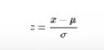

VERY QUICK RECAP:
DATA FEATURING:
STANDARDIZATION
NORMALIZATION
PCA
https://www.youtube.com/watch?v=FgakZw6K1QQ

Slide 4
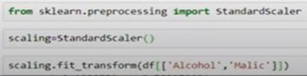
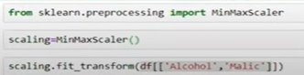
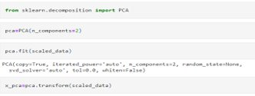
VERY QUICK RECAP:
DATA FEATURING:
STANDARDIZATION
NORMALIZATION
PCA

Slide 5
WHAT IS PIPELINES?
SIMPLY WE PUT MORE THAN ONE FUNCTION IN A BLOCK

Slide 6
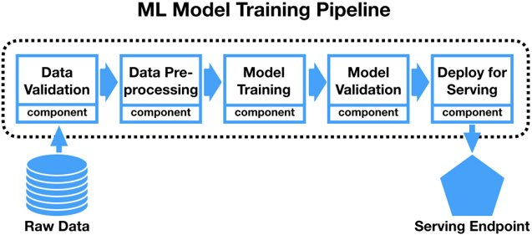
EXAMPLE:

Slide 7
ADVANTAGES?
CODE BECOMES EASY DEBUGGED
CODE IS MANAGED EASILY “READABLE CODE”
IT GIVES RELIABILITY TO MAKE MORE THAN ONE MODEL

Slide 8
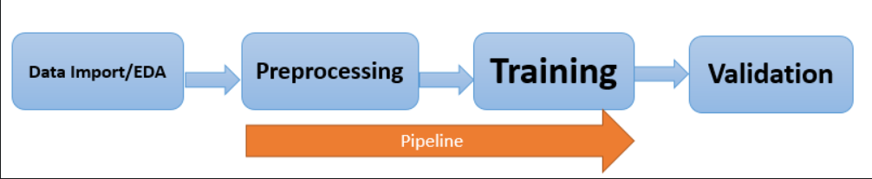
LET'S CODE!

Slide 9
WHAT'S NEXT!

Slide 10
TECHNICAL AND SOFT SKILLS
ANALYTICAL SKILLS
TECHNICAL SKILLS
SOFT SKILLS
PROBLEM SOLVING
DATA CLEANING
DATA ANALYSIS
MATH AND STATISTICS
MACHINE LEARNING
CRITICAL THINKING
RESEARCH SKILLS
BUSINESS ACUMEN AND PRODUCT UNDERSTANDING
COMMUNICATION
CREATIVITY
TEAMWORK
CURIOSITY
STORYTELLING

Slide 11
JOB TITLES AND ROLES
DATA SCIETIST
DATA ANALYST
DATABASE ADMINSTRATOR
MOST GENERAL ROLE
KNOWS A BIT OF EVERYTHING
CAN OFFER BETTER INSIGHTS AND SOLUTIONS
RESPOSIBLE FOR VISUALIZING AND MANIPULATING THE DATA
PREPARE DATA FOR COMMUNICATION
RESPONISBLE FOR DESIGNING THE DATABASES

Slide 12
DATA SCIENCE MARKET IN EGYPT
SOME LINKEDIN PROFILES THAT YOU SHOULD FOLLOW:
https://www.linkedin.com/in/khaled-reda1?miniProfileUrn=urn%3Ali%3Afs_miniProfile%3AACoAADZYNR4BPc0qmkAV8NCtepJaC7Kn9Q8RhVQ&lipi=urn%3Ali%3Apage%3Ad_flagship3_search_srp_all%3Bl5gA1SulTkqeVRJep6ypWA%3D%3D
https://www.linkedin.com/in/mohamed-hammad-a720a622?miniProfileUrn=urn%3Ali%3Afs_miniProfile%3AACoAAASj-HYBZv7Z8pvwgclNe8aBXbp0flT9cvg&lipi=urn%3Ali%3Apage%3Ad_flagship3_search_srp_all%3B2n3I5aC7QTCy%2B1d9q2o1lA%3D%3D
https://www.linkedin.com/in/aman-kumar-b4881440?miniProfileUrn=urn%3Ali%3Afs_miniProfile%3AACoAAAip0mgBobdBf6accrEVa9UWHEdn4bmifAA&lipi=urn%3Ali%3Apage%3Ad_flagship3_search_srp_all%3B42KM0gdlQo2qx4xVyjpOIw%3D%3D
https://www.linkedin.com/in/smritimishra?miniProfileUrn=urn%3Ali%3Afs_miniProfile%3AACoAAC2bEY0BjjcOpuKgS47z8S9pZuWb7Z-7_8s&lipi=urn%3Ali%3Apage%3Ad_flagship3_search_srp_all%3BHH%2FCJKJxRmev8n49LrUpaw%3D%3D

Slide 13
RESOURCES
FULL ROADMAP:
https://www.freecodecamp.org/news/data-science-learning-roadmap/
LEARNING TRACKER:
https://www.notion.so/Data-Science-learning-tracker-0d3c503280d744acb1b862a1ddd8344e
MORE JOB TITLES AND ROLES:
https://towardsdatascience.com/10-different-data-science-job-titles-and-what-they-mean-d385fc3c58ae

Slide 14
INSTRUCTORS CONTACT:
Magdy LinkedIn: https://www.linkedin.com/in/magdy-nasr-a37655192/ Abdel Moez LinkedIn: https://www.linkedin.com/in/abdelmoez-ashraf-8b4880164
Nadeen LinkedIn: https://www.linkedin.com/in/nadeenahmed Nada LinkedIn: https://www.linkedin.com/in/nadaosama769/ Mohamed LinkedIn: https://www.facebook.com/profile.php?id=100007349059005
Omar Facebook Account: https://www.facebook.com/profile.php?id=100009856773680
Sincerely:
It was a brilliant experience for each of the six instructors with such an amazing ambitious data scientists. Trust me, we really learnt from you as much as you learnt from us. Keep going guys and never stop learning. The more you dig deep in this field, the more you feel it’s a game and you will LOVE to play it.

Slide 15

THANKS!
SEE YOU ALL IN THE CELEBRATION EVENT!

